Slide 1
Debugging and improving performance
Dr Kameswarie Nunna
Academic Technical Specialist

Slide 2



What are we going to do?
Diagnose problems
Identify common (?) errors
Evaluate code performance
Over to Ken for vectorisation and memory management

Slide 3
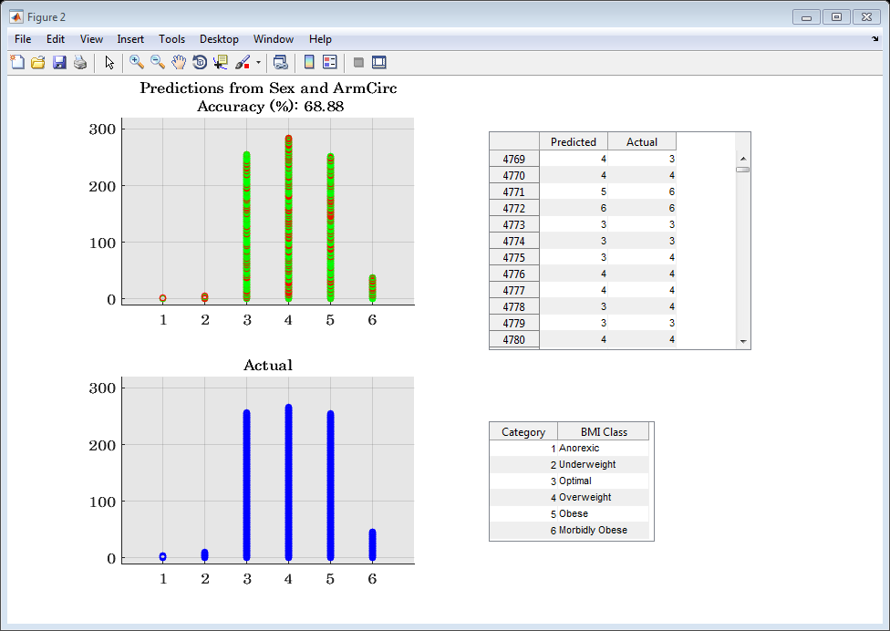
Our function: findBestPredictors
Purpose
Identify two best predictor
variables from the medical
data
Result
findBestPredictors
should return a table of results
render a visualisation of the classified data for the best pair of predictor variables.

Slide 4
Recap: Techniques available
Directory reports: code analyzer report
Current status of the code, “checkcode” function
Preallocation
Entering debug mode
Resolving Dependencies
MATLAB profiler

